Slide 1


Global Tourism Analysis
By Joshua Breuwet

Slide 2
Goals
Our goal was to analyze global tourism markets and determine key countries and regions to focus marketing campaign efforts and funding
Provide travel recommendations for tourists in key markets to be used in campaigns
Some key factors in this analysis are:
Tourism popularity based on total incoming arrivals by tourists
Cruise passenger arrivals
Total tourism expenditure in USD to show where tourists are spending their dollars
The rate of growth of the global tourism market as well as individual markets

Slide 3
Data Cleaning
The data was saved to CSV files from websites and minor cleaning was done using Excel to eliminate unwanted cells, rows, and columns
The CSVs were then read into Jupyter Notebooks and further cleaning was performed using Python to transpose data tables for each country into desired orientation
SQL queries were performed to find differences in individual data sets and Python was used to normalize the data
SQL was used to join all data sets into one main data set for further querying and analysis
Python and Matplotlib was used to generate statistical graphs
Tableau was used to create interactive dashboard

Slide 4
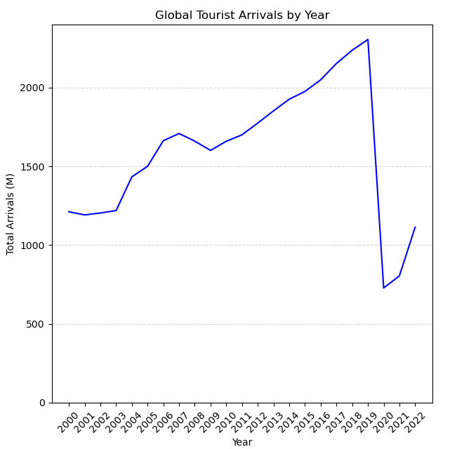
Global Market Overview
Steady growth in tourism from 2000-2019 with a peak of nearly 2.5 billion yearly arrivals
Minor decrease between 2007 and 2009
Huge decrease in global travel in 2019 due to the Covid pandemic
Slow but steady recovery between 2019 and 2022

Slide 5
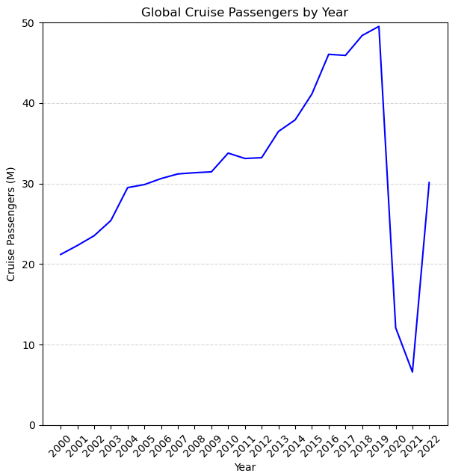
Global Cruise Markets
Global cruise market follows similar trend of global travel with steady growth between 2000 and 2019 with peaks of nearly 50 million passengers in 2019
Cruise markets were more resilient between 2007 and 2009, but growth did slow
Huge decrease in cruise passengers in 2019 due to Covid pandemic
The global cruise markets seems to be making a much faster recovery after 2019 then global travel as a whole

Slide 6
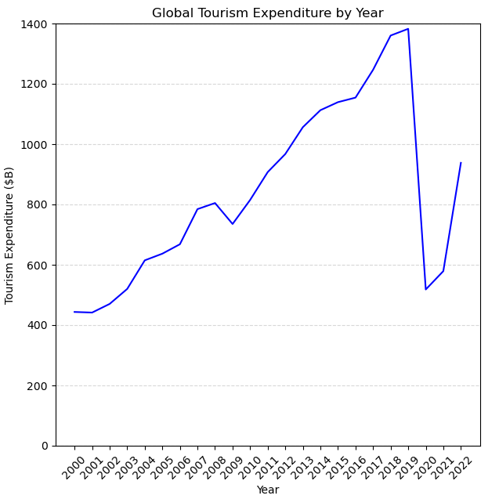
Global Tourism Expenditure
Global tourism expenditure in USD follows a similar trend as the other data but sees very rapid growth from 2009 to 2019 with peaks reaching nearly $1.4 trillion
Again, we see a very heavy decline in expenditure following 2019 due to Covid and the decrease in global travel
Global tourism expenditure experiences much more rapid growth following 2019 compared to global travel, this could be due to rising inflation worldwide

Slide 7
Most Popular Markets
Largest AVG Tourism Markets 2000-2022
Country Total Arrivals (K)
FRANCE 163,067
USA 129,212
CHINA 112,736
SPAIN 94,223
MEXICO 87,599
ITALY 70,622
POLAND 67,102
CROATIA 47,539
HUNGARY 41,619
HONG KONG 32,958
Largest AVG Tourism Markets 2010-2022
Country Total Arrivals (K)
FRANCE 191,404
USA 150,950
CHINA 114,481
SPAIN 99,398
MEXICO 80,094
ITALY 75,178
POLAND 70,995
CROATIA 49,369
HUNGARY 46,484
HONG KONG 41,651
Largest AVG Tourism Markets 2020-2022
Country Total Arrivals (K)
FRANCE 86,135
SPAIN 64,336
POLAND 57,972
MEXICO 57,474
USA 54,085
ITALY 50,974
HUNGARY 38,224
CROATIA 35,251
TURKEY 32,466
CHINA 26,365

Slide 8
Most Popular Cruise Markets
Largest AVG Cruise Markets 2000-2022
Country Cruise Passengers (K)
MEXICO 5,755
BAHAMAS 3,623
SPAIN 2,606
US VIRGIN ISLANDS 1,662
GREECE 1,612
CAYMAN ISLANDS 1,524
SAINT MAARTEN 1,324
PUERTO RICO 1,202
JAMAICA 1,151
RUSSIA 881
Largest Cruise Markets 2010-2022
Country Cruise Passengers (K)
MEXICO 5,857
BAHAMAS 4,145
SPAIN 2,606
GREECE 2,140
US VIRGIN ISLANDS 1,530
CAYMAN ISLANDS 1,473
SAINT MAARTEN 1,404
RUSSIA 1,394
JAMAICA 1,227
PUERTO RICO 1,115
Largest Cruise Markets 2020-2022
Country Cruise Passengers (K)
MEXICO 3,803
BAHAMAS 2,610
SPAIN 1,510
GREECE 870
DOMINICAN REP. 667
CAYMAN ISLANDS 640
HONDURAS 550
PUERTO RICO 543
SAINT MAARTEN 504
JAMAICA 457

Slide 9
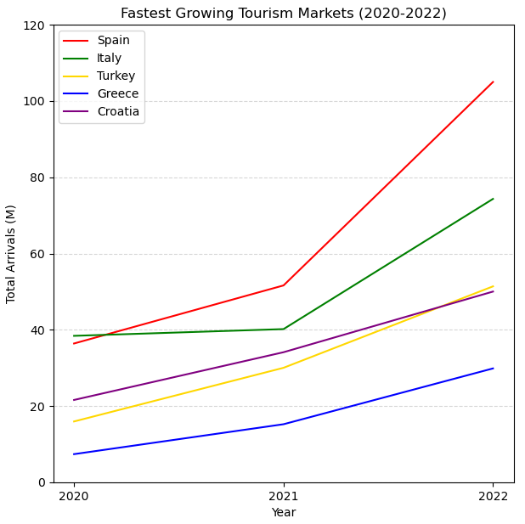
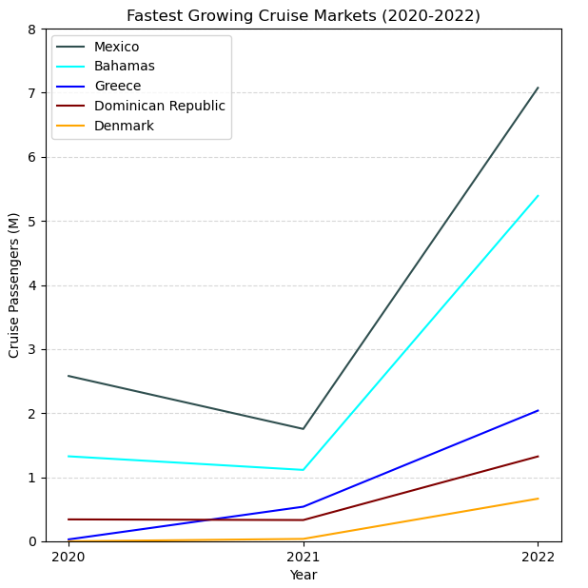
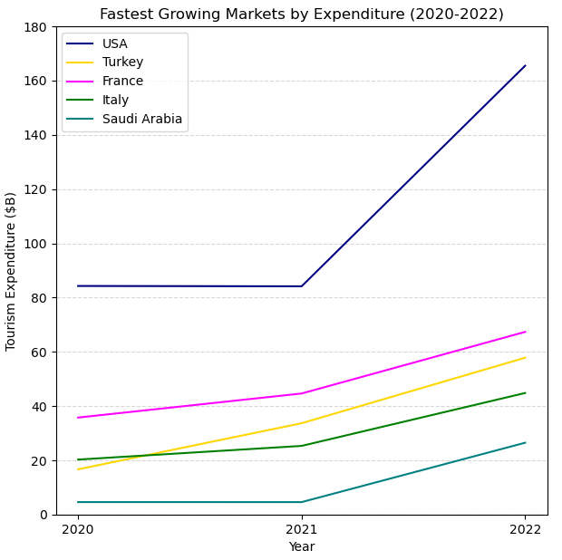
Fastest Growing Markets Post Covid

Slide 10
Findings
Tourism marketing spending and efforts can be focused in some key markets that are experiencing success over the past two decades as well as after the Covid pandemic
Countries like France, Spain, Poland, Mexico, and the USA are the leading tourism markets by number of arrivals since the year 2020
Countries like Mexico, the Bahamas, and Spain have consistently been the largest cruise markets globally
Attention should be given to some of the fastest growing markets coming out of the Covid pandemic which include Spain, Italy, Turkey, Greece, and Croatia
Global travel hasn’t quite completely recovered since the pandemic but more people every year are traveling the globe, and I believe we should see a full recovery in just a few years time

Slide 11
Data Sources and Limitations
The data in these sets only contained data up until the year 2022, further analysis after tourism data is updated for the years 2023 and 2024 would gain further insight
Not all the data was complete for every country
Cruise passenger reporting missing for certain countries
Safety and crime data missing for certain countries
Data Sources:
UN global tourism data and key statistics: www.untwo.org
Global population data: www.population.un.org
Global GDP data: www.imf.org
Global safety and crime data: www.worldpopulationreview.com

Slide 12
Thank you for your time! Let’s take a look at the interactive dashboard…

